Slide 1

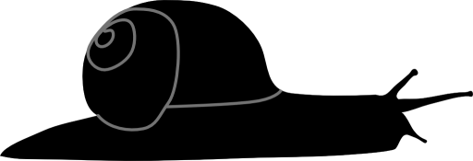
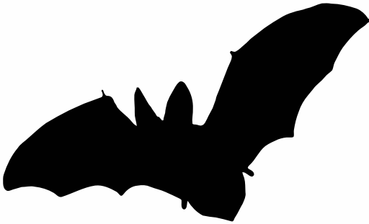

“As buds give rise by growth to fresh buds, and these, if vigorous, branch out and overtop on all sides many a feebler branch, so by generation I believe it has been with the great Tree of Life, which fills with its dead and broken branches the crust of the earth, and covers the surface with its ever-branching and beautiful ramifications.” — Darwin
PhyloMeth
Brian O’Meara

Slide 2


Made possible by:

Slide 3
PhyloMeth
Brian O’Meara

